Slide 1





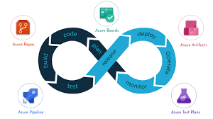




System Administration - Basics

Slide 2
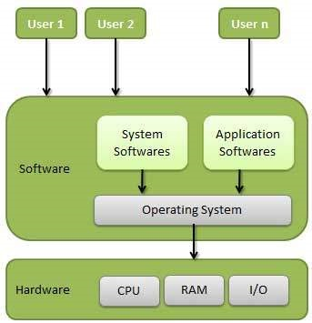
Operating System ?
An operating system (OS) is system software that manages computer hardware, software resources,
and provides common services for computer programs.

Slide 3
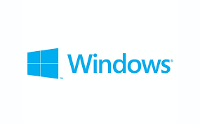




Common Operating Systems
Microsoft windows
Linux
Apple Macinthosh OS
Apple iphone OS
Android

Slide 4
Microsoft Windows OS
Windows is a graphical operating system developed by Microsoft. It allows users to view and store files, run the software, play games,
watch videos, and provides a way to connect to the internet. It was released for both home computing and professional works.
Popular Versions of Windows OS
Client – Windows7, Windows8, Windows10, windows11
Server – Windows2000, Windows2003, 2008, 2012, 2016, 2019

Slide 5
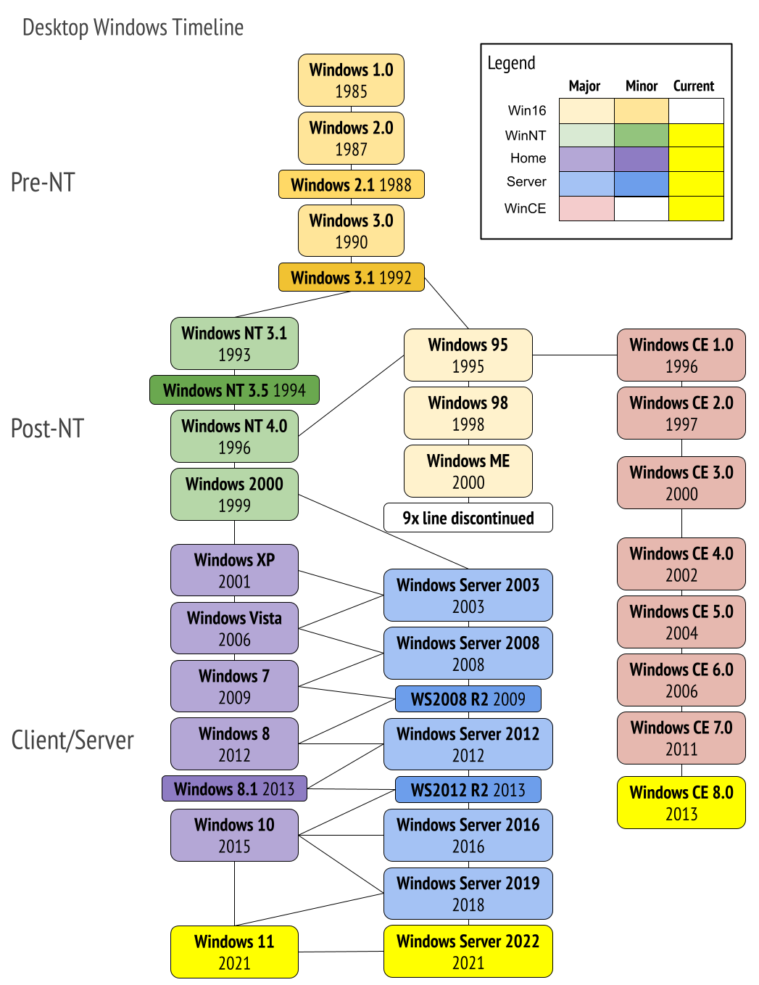
Versions of Windows OS

Slide 6
Service management in Windows OS – services.msc
Command Prompt:
PowerShell
Command | Function
sc config | Configures service startup and login accounts
sc continue | Resumes a paused service
sc enumdepend | Lists the services that cannot run unless the specified service is running
sc failure | Specifies what action to take upon failure of the service
sc pause | Pauses a service
sc qc | Displays the configuration of a particular service
sc query | Displays information about the specified service, driver, type of service, or type of driver
sc start | Starts a service running
sc stop | Sends a STOP request to a service (not all will respond)
Command Function
Get-Service allows to get the services on a local or remote computer
both in running or stopped state;
New-Service creates a service. The cmdlet creates a new entry for a Windows service
in the registry and in the service database;
Restart-Service restarts a service. The cmdlet sends the restart message through
the Windows Service Controller;
Resume-Service resumes a service. The cmdlet sends a resume message
to Windows Service Manager;
Set-Service changes the settings of a local or remote service, including its state, description,
displayed name or startup mode. You can also use this cmdlet
to start, stop or suspend a service;
Start-Service starts a service;
Stop-Service stops a service (the cmdlet sends a stopping message to Windows Service Manager);
Suspend-Service suspends a service. A suspended service is still running,
but it does not do anything till it is resumed using
( for example, with the Resume-Service cmdlet).

Slide 7
Get-LocalUser
Local User management in Windows OS – lusrmgr.msc
Command Prompt:
PowerShell
Command | Function
net user | To list the user names having account on the local system
net localgroup | To list the group names having account on the local system
net user username password /ADD | To add a new user account on the local computer
net user /add John * | To add a new user account on the local computer without password visible
net localgroup group_name UserLoginName /add | To add new localgroup
net user username | findstr /B /C:"Last logon" | To list last time login of user
Net user John /active:no | To disable user account
Command Function
Get-LocalUser To List local user
Get-LocalGroup To list Local group names
New-LocalUser To create new user
Add-LocalGroupMember To add new Group

Slide 8
Get-LocalUser
File management in Windows OS
Command Prompt:
Command Function
cd/chdir change directory
copy This command copies a specified file to a given location
del/erase deletes a file or number of files
dir displays the current files and folder
find searches a specific file for a given string.
md/mkdir creates a new directory
move copy/paste command that move a file from one location to another
ren/rename to rename directories
rd/rmdir to remove a directory
tree Displays a graphical file tree of the the specified file path, or the current drive if no path is specified.

Slide 9
Get-LocalUser
Network commands
command Function
ping The Ping command allows you to test the reachability of a device on a network.
IPconfig displays basic IP address configuration information for the Windows device you are working on
hostname display the current name of your computer
nslookup Displays information that you can use to diagnose DomainName System (DNS) infrastructure
tracert This command will trace the route a data packet takes before reaching its destination, displaying information on each hop along the route
netstat The Netstat command displays active TCP connections, ports on which the computer is listening
systeminfo Displays a detailed list of configuration information about your computer

Slide 10
Thank you…!!!

